Slide 1
CustomCut: On-demand Extraction of Customized 3D Parts with 2D Sketches
Symposium on Geometry Processing 2016
Xuekun Guo¹, Juncong Lin², Kai Xu³, Siddhartha Chaudhuri⁴, Xiaogang Jin¹
¹State Key Lab of CAD&CG, Zhejiang University, China
²Software School of Xiamen University, China
³National University of Defense Technology, China
⁴Indian Institute of Technology Bombay, India
Notes:
Good morning everyone, I’m xuekun guo, from the state key lab of CAD&CG [dʒiː], Zhejiang university, china.
I’m glad to introduce my work “CustomCut: On-demand Extraction of Customized 3D Parts with 2D Sketches”. Five researchers collaborated in the work.
[end]

Slide 2

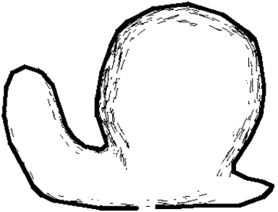
Introduction
Notes:
Sketch-based interfaces provide an intuitive way to create and explore 3D shapes.
As illustrated in the figure, the user sketches the outline of the desired shape. The 3D shape is generated through inflating the region surrounded by the silhouette.
However, most humans cannot draw very well. Hence, sketch-based interfaces need to interpret a crude [Kru:d] drawing and map it to a detailed shape.
[end]

Slide 3
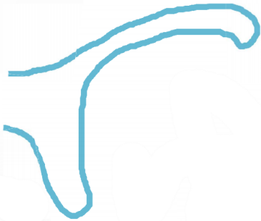
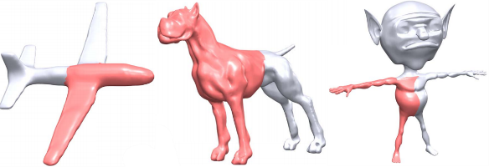
Introduction
Notes:
This problem could be tackled in a data-driven manner:
As illustrated in the figure, each sketched component is used to search a repository for high-quality shapes with matching parts (the red parts),
which can be extracted and incorporated into the design.
[end]

Slide 4
Introduction
Partial Matching Problem!
Notes:
Matching a sketched component to a shape database is a challenging partial matching problem.
[end]

Slide 5
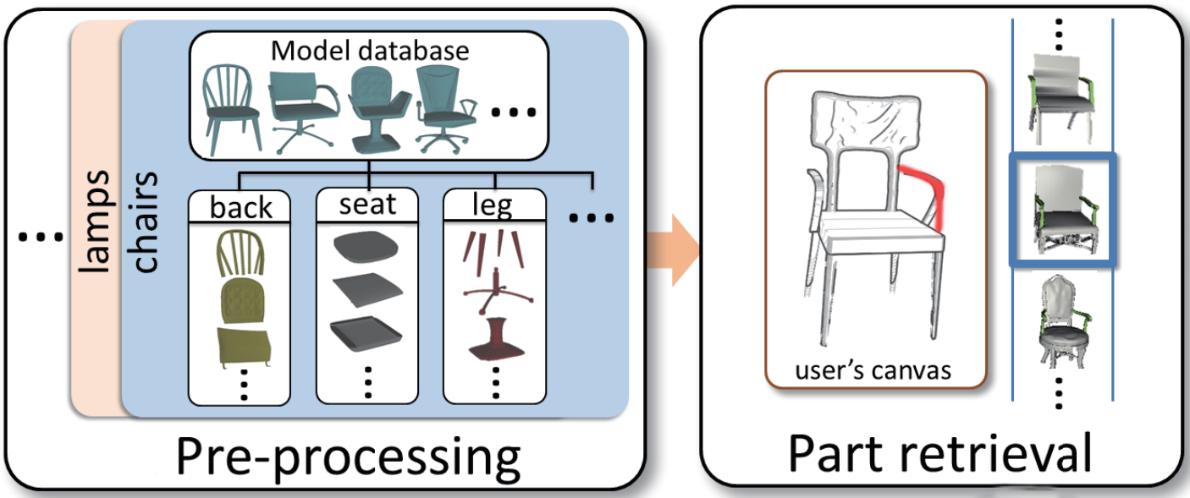
Introduction
Most existing methods reduce it to one of global, rather than partial matching.
Notes:
Existing methods leverage a prior segmentation of each shape into predefined semantic parts.
As illustrated in the figure, during the pre-processing stage, the database shapes are segmented into standard parts.
At the part retrievals stage, the pre-segmented parts are individually matched to the sketch, reducing the problem to one of global, rather than partial matching.
[end]

Slide 6
Challenges
Potentially infinite search space.
<--- A strategy to carefully balance between returning all possible matches, and providing an overly narrow set of matches.
Matching scheme must be fast.
<--- Projective approach and turn the 3D partial matching problem into a 2D contour-based one.
Notes:
Designing such an algorithm presents hard technical challenges.
Since a pre-segmented (or pre-labled) database is not available to us,
we must simultaneously identify and extract parts that match sketched strokes, resulting in a potentially infinite search space.
To prune this search space to a manageable size,
we design a strategy to carefully balance between returning all possible matches, and providing an overly narrow set of matches.
Further, the matching scheme must be fast enough so that appropriate candidate parts can be sought interactively.
To address this challenge, we take a projective approach and turn the 3D partial matching problem into a 3D contour-based one.
The 2D contours of all database shapes are segmented into fragments and organized based on fragment similarity, using an efficient data structure.
Given a query sketch, our method can leverage the structure to quickly return all potentially matched parts via contour matching and match propagation.
[end]

Slide 7
Contribution
Fast, sketch-based partial 3D shape matching method based on multi-view projections.
Novel customized segmentation method based on a super-face graph.
Notes:
Our paper has two main technical contribution:
A fast, sketch-based, partial 3D shape matching method based on multi-view projections.
The projections are interlinked by matching fragments across different shapes, based on a novel randomized compound k-nearest neighbors graph representation.
A novel customized segmentation method based on a super-face graph.
The method quickly extracts candidate parts conforming to a user’s sketch from a matched shape.
The extraction employs a coarse-to-fine strategy to progressively refine part boundaries down to the level of individual faces.
[end]

Slide 8
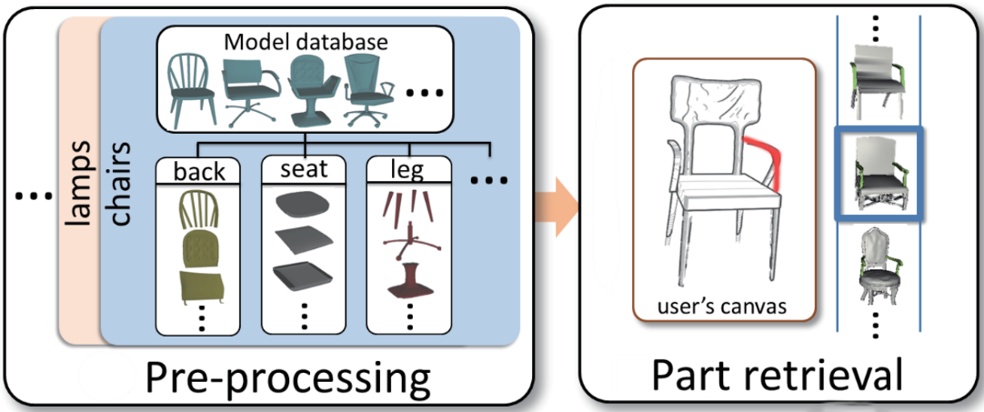
Related work
Sketch-based shape retrieval. [LF08, XXM∗13, ERB*12]
Notes:
Our work closely relates to the sketch-based shape retrieval techniques.
As illustrated in the figure, these systems assume the parts are pre-generated by automatic segmentation, and hence retrieval reduces to global 2D-to-3D matching.
These systems do not allow the user to generate new parts with novel cuts, or retrieve groups of pre-existing parts with one sketch.
In contrast, our approach supports arbitrary cuts of exemplar shapes, driven by the sketch.
Further, because shapes are not pre-segmented, we must do partial matching from 2D to 3D at interactive rates, which is a significant technical challenge.
[end]

Slide 9
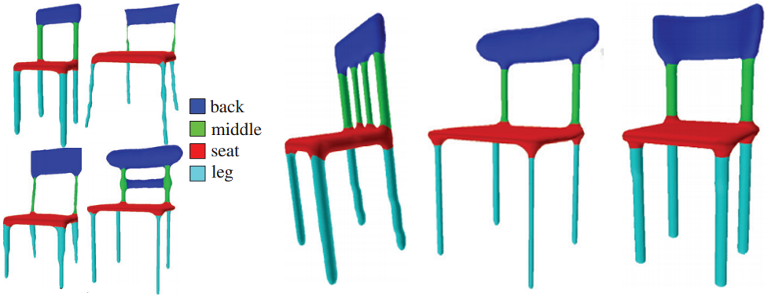
Related work
Shape segmentation. [Sha08, CGF09, KHS10, HKG11, SvKK*11]
Training meshes
Segmentation results
Notes:
Our work falls into the category of shape segmentation.
As illustrated in the figure, joint shape segmentation methods typically assume a pre-segmented and pre-labeled shape database.
In contrast to these methods, the shape segmentation method we develop does not assume a pre-segmented and pre-labeled shape database.
Instead, we retrieve and segment shapes in real time based on a user sketch. An on-the-fly and contour-aware segmentation method is required.
[end]

Slide 10
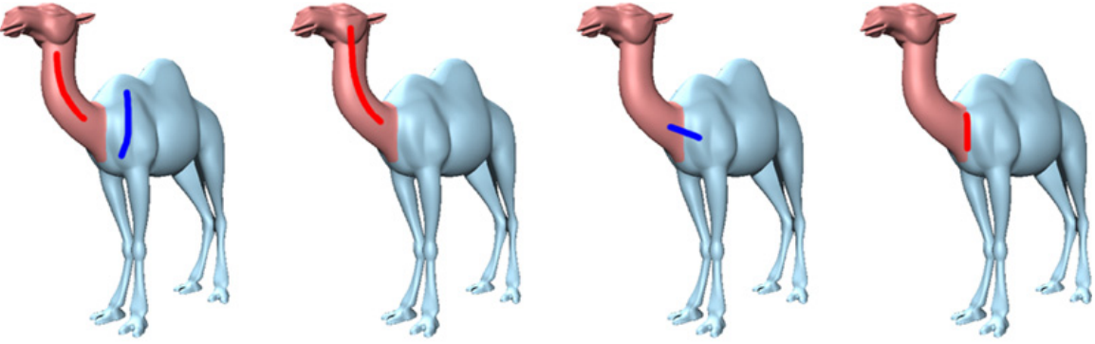
Related work
Sketch-based mesh cutting. [FML12]
Different user interfaces of various sketch-based mesh cutting algorithms.
Notes:
As illustrated in the figure, sketch-based mesh cutting techniques typically require the user to sketch on the source shape, identifying the foreground, background, or the cutting line.
In contrast to these methods, we do not know the source shape in advance, and we do not sketch directly on the source shape.
Instead, we perform 2D-3D partial matching to automatically retrieve database shapes matching the query sketch.
[end]

Slide 11
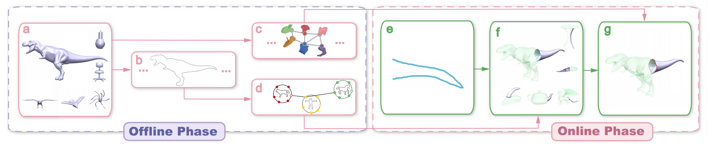
Overview
Offline phase.
Organize shape contours into compound k-nearest neighbors graph (RC-kNNG).
--> for fast 2D-3D shape partial matching.
Extract the super-face graph (SFG) for each database shape.
--> for fast contour-driven 3D part extraction.
Online phase.
The input sketch is used to retrieve partially matching shapes (via the RC-kNNG) and extract candidate parts (via the SFG) from these shapes.
Notes:
This figure illustrates the pipeline of our work.
In the offline phase, we extract boundary contours for each model in the database from different camera views (as illustrated in (b)). The shape contours are then organized into the compound k-nearest neighbors graph (as illustrated in (d)).
This data structure is used for fast 2D-3D shape partial matching.
For each database shape, we extract the super-face graph representation (as illustrated in (c)).
The super-face graph representation is used for fast contour-driven 3D part extraction.
In the online phase, the input sketch is used to retrieve partially matching shapes (via the RC-kNNG, as illustrated in (f))
and extract candidate parts (via the SFG representation, as illustrated in (g)) from these shapes.
[end]

Slide 12
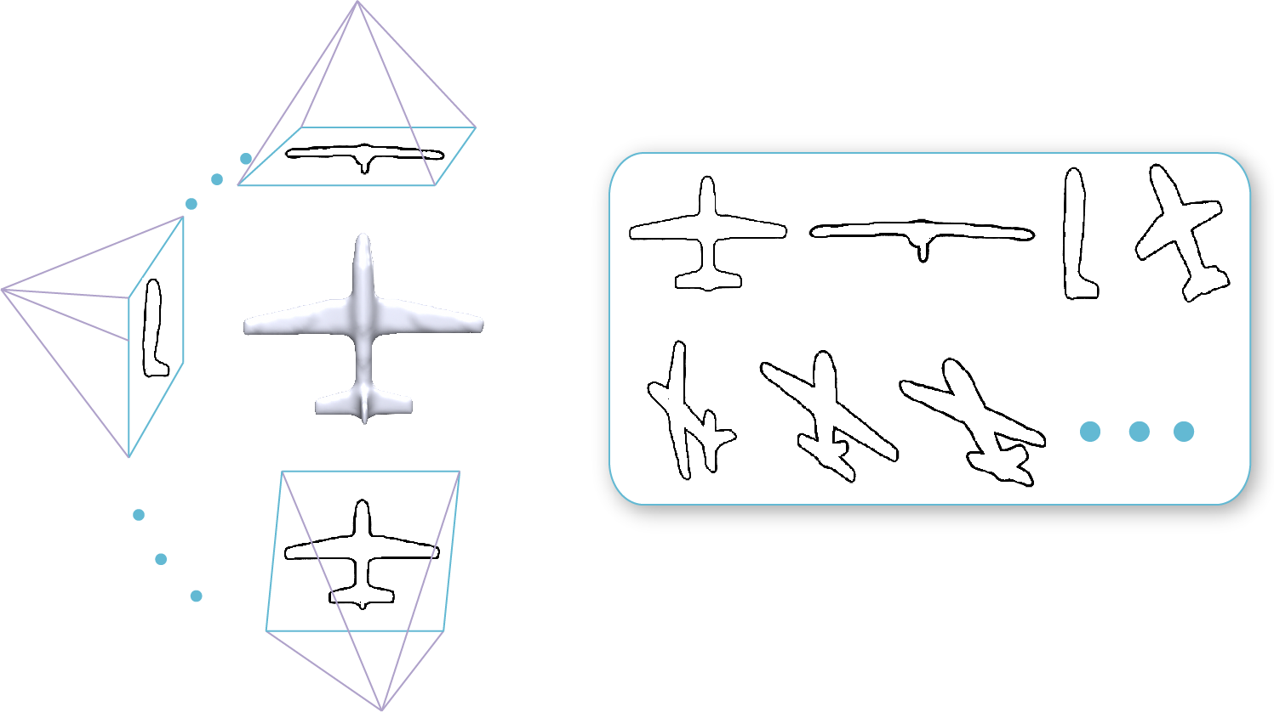
Data structure for fast partial matching
2D matching between the sketch and a section of one of these exemplar contours
2D-3D partial matching
Notes:
At runtime, the system rapidly searches the database to find parts matching the user sketch.
Notice that we support searching for arbitrarily shaped parts, not just those matching a “standard” pre-segmentation.
Hence, we must process each database shape on the fly, identifying which section of the shape matches the sketch.
This requires an extremely fast 2D-3D partial matching method.
Recall that in the offline phase we obtain boundary contours of each database shape from different camera views (See this figure).
The 2D-3D partial matching problem reduces to matching the sketch to a section of one of these exemplar contours.
[end]

Slide 13
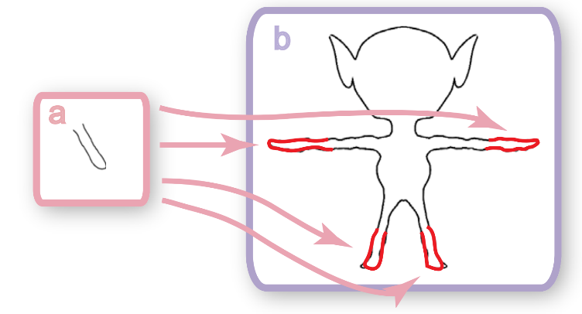
Data structure for fast partial matching
The Randomized Compound k-Nearest Neighbors Graph (RC-kNNG)
A contour to be connected to several different sets of k neighbors.
Notes:
To rapidly find database shapes whose contours match the sketch,
we propose a new data structure: the Randomized Compound k-Nearest Neighbors Graph.
The RC-kNNG has as its vertices all rendered contours of all database shapes.
Notice that in our partial matching scenario, a single contour may match a query contour in more than one section.
As illustrated in the figure, the sketch in (a) matches four different sections of the database shape contour (illustrated in (b)).
To reflect this, our graph allows a contour to be connected to several different sets of k neighbors.
Each such set corresponds to a different matched section.
This is the key difference between our RC-kNN graph and the standard kNN graph.
Thus, from a partial match in one shape, we can quickly find several other partial matches with similar geometry in other shapes.
[end]

Slide 14
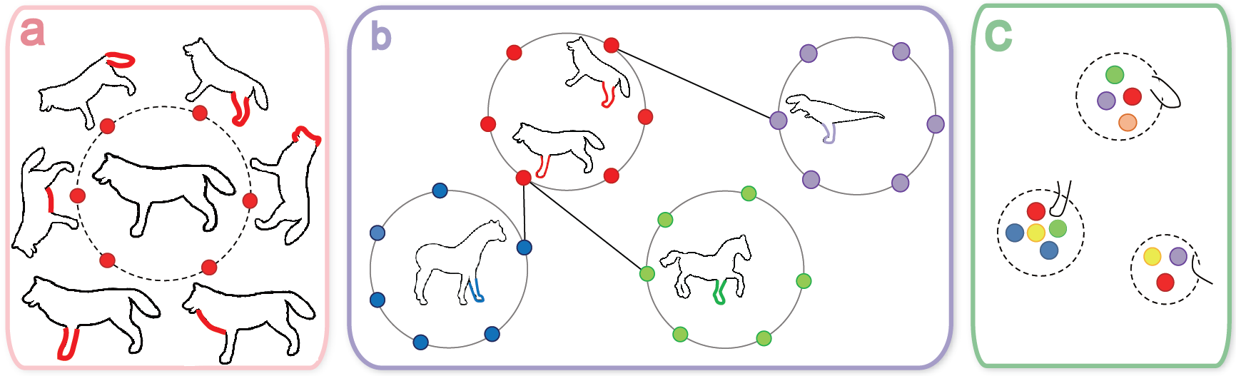
Data Structure for Fast Partial Matching
Construction of the RC-kNNG
Notes:
Direct construction of the RC-kNNG by exhaustively comparing all possible sections of all pairs of contours is prohibitively expensive.
Instead, we choose to approximate the graph with a double-random strategy:
We first generate several sections from each contour (as illustrated in (a)).
Then we adopt a multiple random divide-and-conquer strategy to construct a kNN graph of all the sections (as illustrated in (b)).
At last, we sample a sparse set of sections which will be used as seed points for queries (as illustrated in (c)).
[end]

Slide 15
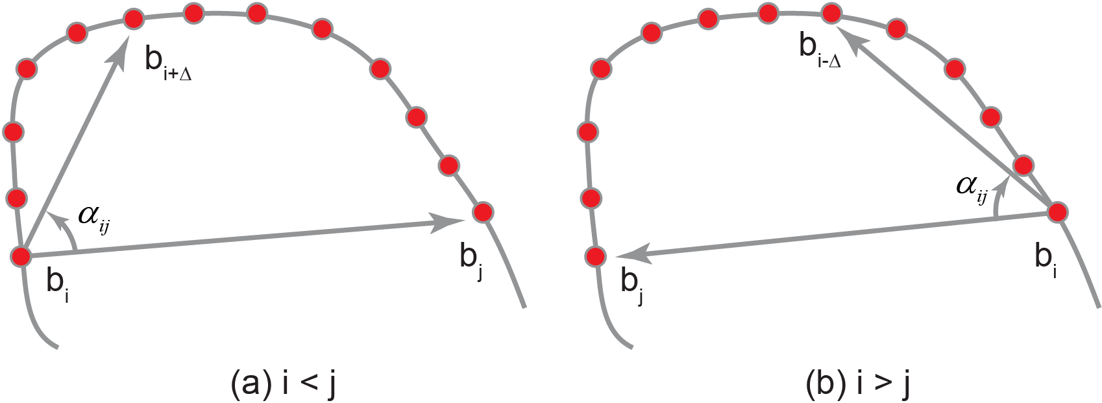
Candidate Shape Retrieval
Compare the query contour to all seed sections in the RC-kNNG.
Traverse the graph in a best-first manner.
We continue until we have enough matching sections.
Notes:
We need to identify a group of partially matching shapes from which candidate parts will be presented to the user.
To achieve this, we query the RC-kNNG for a larger number of matching contour sections, and compute a score for each parent shape.
The group of shapes with highest scores are presented in the interface.
We first compare the query contour to all seed sections in the RC-kNNG.
Then we traverse the graph in a best-first manner.
The traverse process continues until we have popped and stored enough matching sections.
Then we aggregate the contour sections and obtain the associated database shapes.
For each shape, we compute a score according to the matched sections in the shape contour.
The shapes are ranked according to the score.
To compare two contour sections, we generate contour descriptors.
Intuitively, the descriptor describes the relative spatial arrangement of the sampled points on the contour.
The particular descriptor we employ is a matrix of angles.
As illustrated in the figure, the angle is calculated between a chord (b_i, b_j) from a reference point b_i to another sampled Point.
[end]

Slide 16
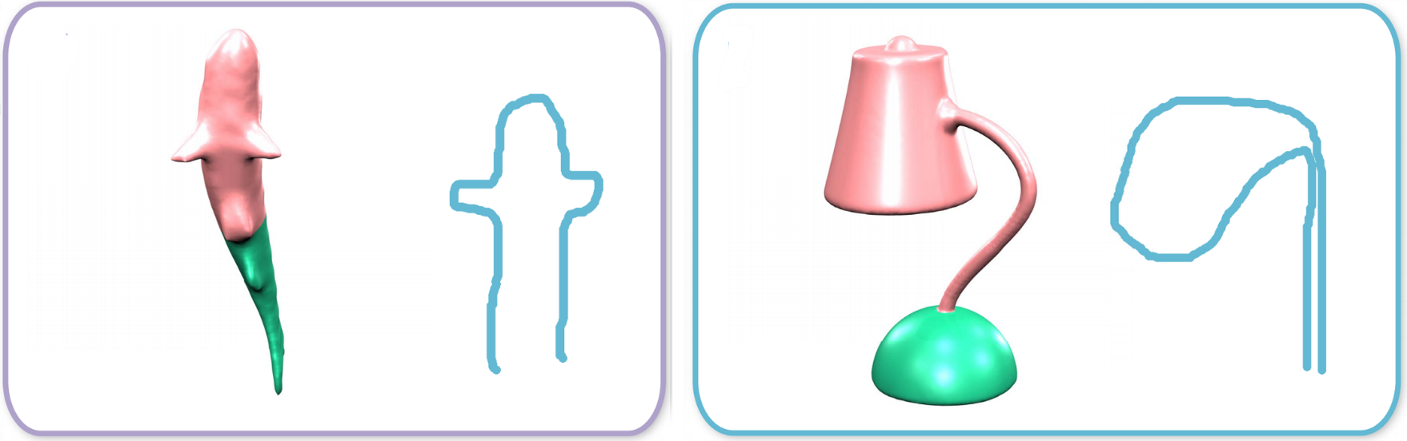
Progressive Part Extraction: Challenges
The contour boundary may be irregular and not directly correspond to a semantic part boundary.
A single contour may cover more than one semantic part.
The segmentation process should run at interactive speeds.
Notes:
When a user select a candidate shape with a contour section matching the sketch,
we must quickly and accurately identify and extract the corresponding part.
This presents several challenges:
The contour boundary may be irregular and not directly correspond to a semantic part boundary (as illustrated in the left figure).
Hence, it can be identified only with reference to the user’s sketch.
2. A single contour may cover more than one semantic part.
As illustrated in the right figure, the contour covers the head and neck of the lamp.
3. The segmentation process should run at interactive speeds.
[end]

Slide 17
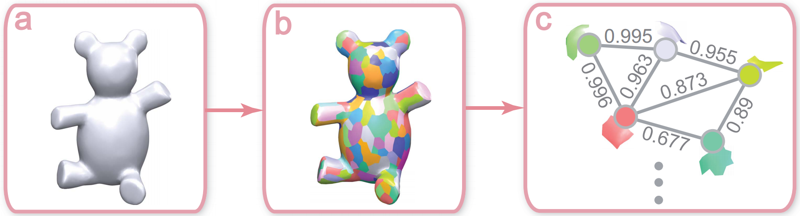
The Super-face graph (SFG)
Vertices <----> Super-faces
Edges <----> Adjacent relationship
Weights <----> Probabilistic prior for merging super-faces into larger patches
Notes:
We address these challenges with a new super-face graph representation (SFG) for a 3D shape.
The figure illustrates the construction of the super-face graph representation.
The SFG is a discretized yet fine-grained version of the original model.
The vertices of the graph are a set of super-faces, obtained by an over-segmentation of the model that respects strong feature boundaries.
Edge of the graph connect pairs of adjacent super-faces.
The weight of an edge indicates how frequently the super-face pair co-occurs in a single segment.
The SFG gives us a probabilistic prior for merging adjacent super-faces into larger patches to represent and arbitrary but not implausible or disconnected part of the shape.
We generate the SFG representation of all database models in the offline phase.
Hence, we find candidate parts as combinations of super-faces, and subsequently refine the part boundaries down to the level of individual faces.
[end]

Slide 18
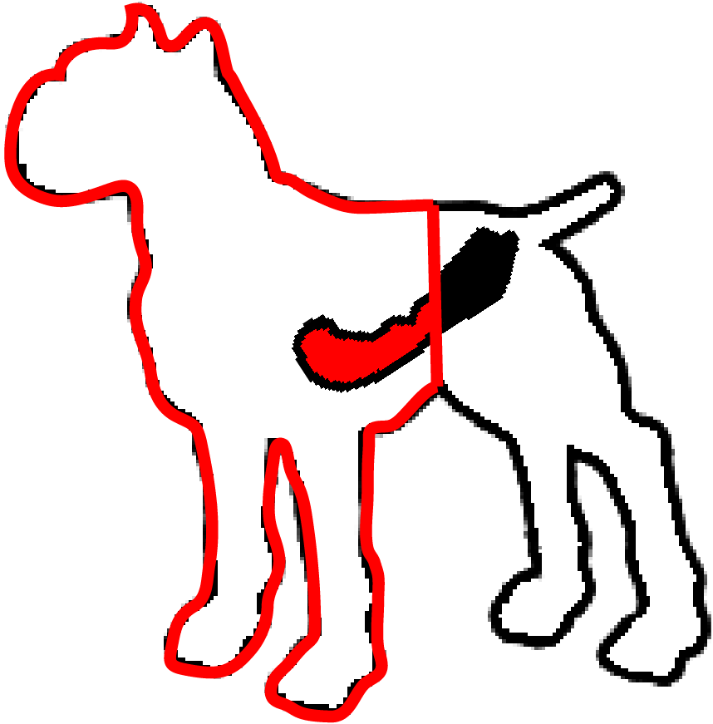
Coarse-to-fine 3D part extraction
Super-face level
Contour closure
Notes:
The coarse-level part extraction works on the super-face level.
We formulate the problem as a binary labeling problem which can be solved by minimizing a Gibbs energy.
The first term encodes the contour closure constraint.
The contour closure constraint is that the line joining the ends of a contour section forms a natural perceptual boundary for the part. Hence, the part’s projection should respect this line as much as possible.
P(i) is defined as the fractional area of the i-th super-face lying within the contour closure.
[end]

Slide 19
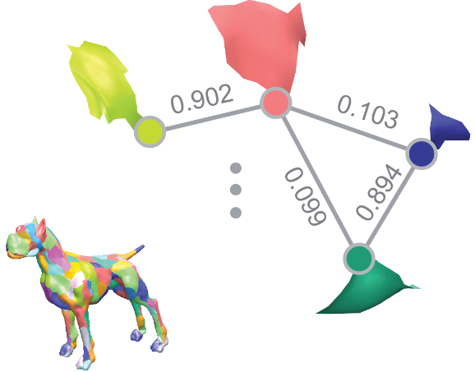
Coarse-to-fine 3D part extraction
Super-face level
Super-face Co-occurrence
Notes:
The second term encodes the Super-face co-occurrence:
If two super-faces regularly co-occur in the same segment of a random segmentation,
They should probably both be retained or both excluded from the part. This acts as a shape prior.
e_ij is the edge weight of the SFG.
[end]

Slide 20
Coarse-to-fine 3D part extraction
Face level
Concavity
Smoothness
Notes:
After obtaining the coarse level part, we refine the boundary in the face level to minimize the following energy.
E_v reflects the Concavity constraint.
Shape concavity information plays an important role in achieving high-quality segmentation
as concave creases and seams are generally regarded as natural segmentation boundaries by humans.
E_s reflects the Smoothness constraint. The boundary should avoid sharp zigzags.
[end]

Slide 21
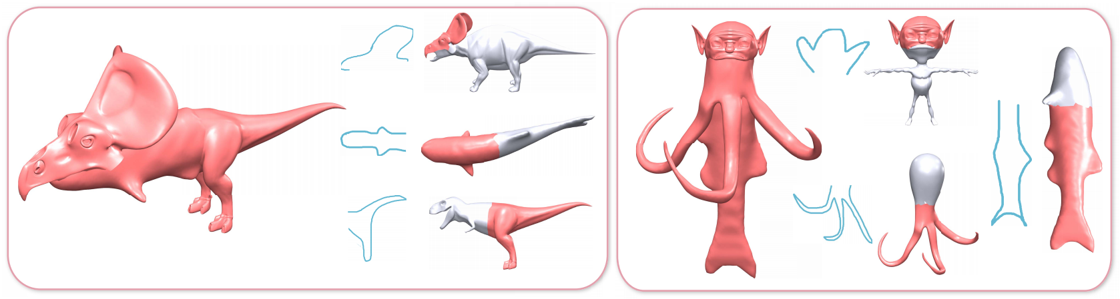
Application
Sketch-driven assembly-based modeling
Notes:
As our method does not rely on a pre-segmented database, it can retrieve more diverse parts for composition.
In each subfigure, we show the designed models (red), the user’s sketches (blue), and the part suggestions selected by the user.
[end]

Slide 22
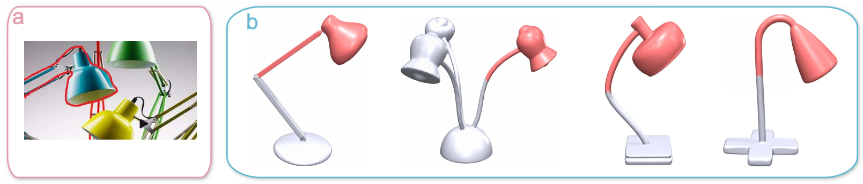
Application
Contour-driven shape completion
Notes:
Our algorithm can be used to help recover hidden geometry. Our 2D-3D partial matching method could helps the user infer the occluded portion.
Given a photograph of an occluded lamp, the user traces the outer boundary of the visible portion.
This trace is used as the query contour. Our algorithm retrieves possible completions for the object from a database of lamps.
[end]

Slide 23
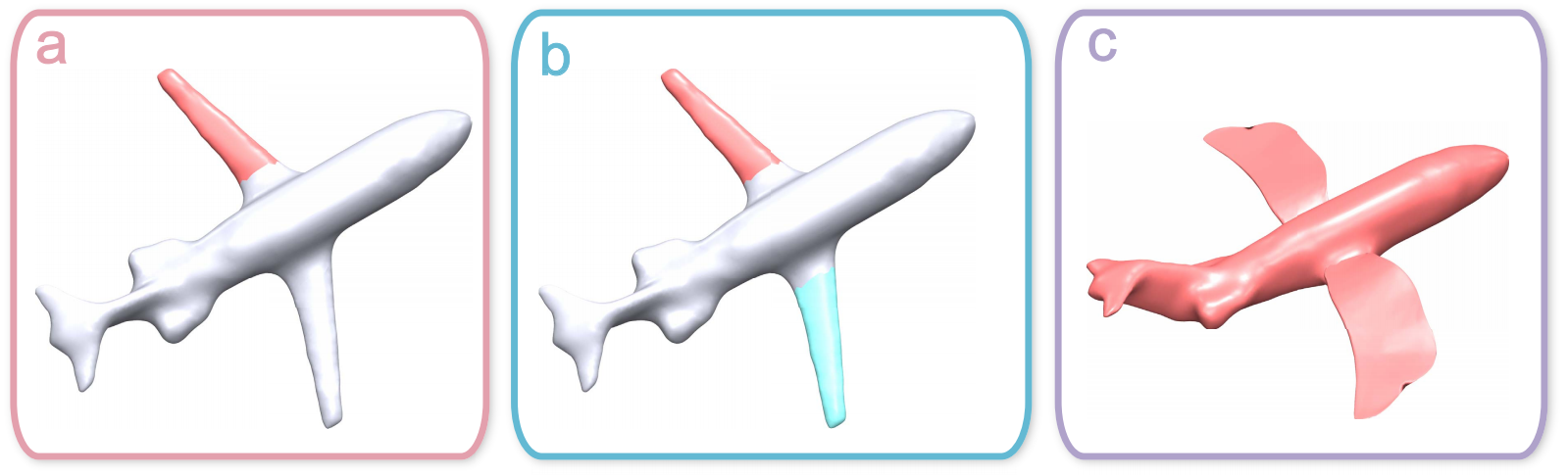
Application
Symmetry-aware selection and editing
Notes:
Our method can also be used to select a group of similar elements in a single shape for further editing.
As illustrated in the figure, the user picks part of the wing. Note that it is not the complete wing, i.e. it is not a “standard” segment.
The corresponding regions of the other wing will be automatically identified, by partial matching of the contour of the selected region with the rest of the shape itself.
Subsequently, the entire selected group can be replaced by similar parts retrieved from the database.
[end]

Slide 24
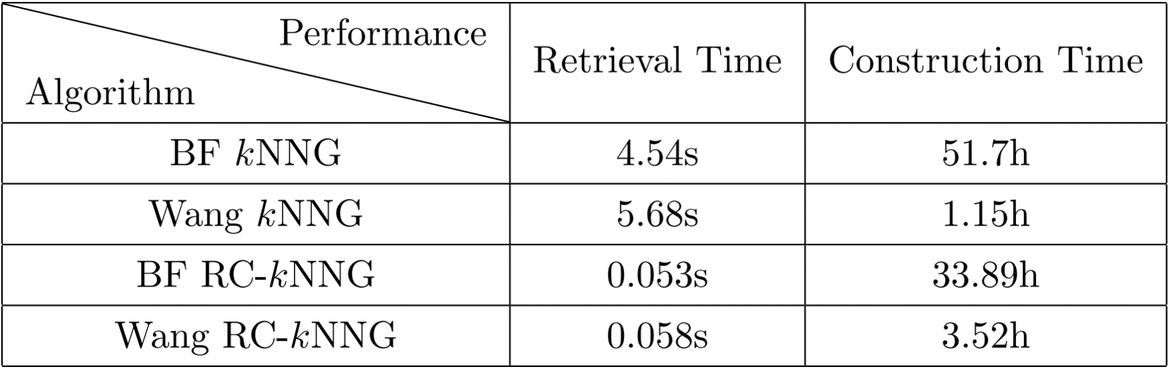
Evaluation: RC-kNNG retrieval performance
BF kNNG: Traditional kNNG constructed by brute force.
Wang kNNG: Wang’s randomized kNNG approximation.
BF RC-kNNG: RC-kNNG constructed by brute force.
Wang RC-kNNG: our method.
Notes:
To evaluate the retrieval performance of our method, we compare the four following methods.
The first method BF kNNG, is the traditional kNNG constructed by brute force.
The second method Wang kNNG, is the traditional kNNG constructed by the graph approximation method adopted by our method.
The third method BF RC-kNNG, is the RC-kNNG constructed by brute force.
The fourth method Wang RC-kNNG, is our method.
For the two kNNG methods (the first one and the second one), nodes of the graph are complete shape contours.
Node adjacencies and edge weights are identified by global comparison of shape contours.
When searching for partial matches to a query contour, we must extract similar contour sections explicitly,
significantly slowing down both methods.
The table gives retrieval performance for the four methods on our test dataset.
It is clear that our method (circled by the red rectangle) has the best performance.
For retrieval, it is about 97 times faster than Wang’s kNNG, with only 3 times the construction time. The kNNG approaches, which require explicit partial matching at runtime, are much slower.
[end]

Slide 25
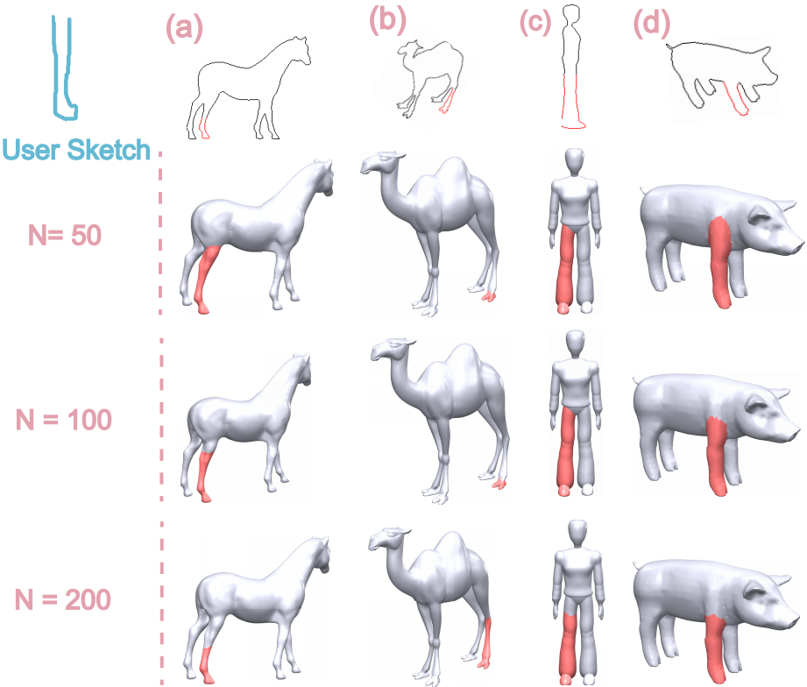
Evaluation: Increasing super-face counts
Notes:
This figure shows the improvement in part extraction as we increase the number of super-faces. In each column, we show the contour section matching to the user sketch, the candidate part extracted under different super-face counts.
With fewer super-faces, the search space is relatively coarse and the extracted parts need not perfectly match the sketch.
As we increase the number of super-faces, the search space becomes more fine-grained.
The part contours match the sketch better and better, and the part boundaries are less constrained to follow suboptimal cuts.
[end]

Slide 26
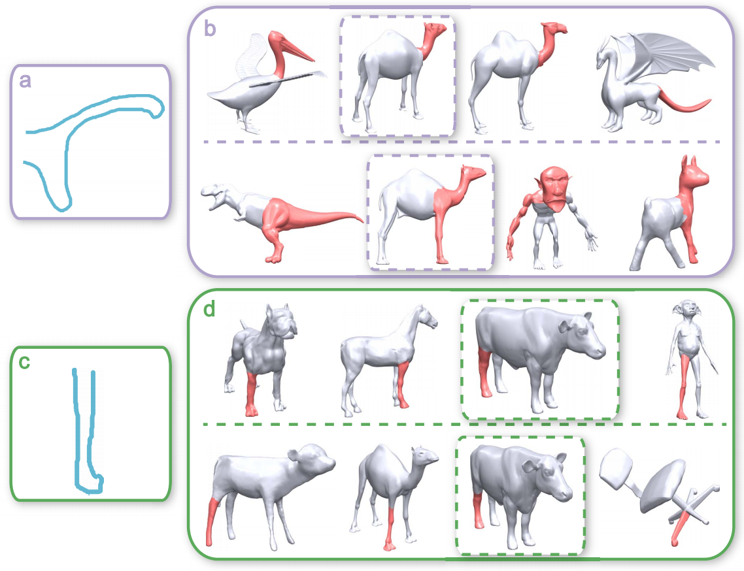
Evaluation: Comparison to pre-segmentation approach
Retrieval results generated with the pre-segmentation method (upper rows in (a) and (b)) and our method (lower rows in (a) and (b)).
Notes:
We compare our method to an approach based on a pre-segmented database of parts.
Given the user’s sketch (figure (a) and (b)), we show the retrieval results generated with the two methods.
In (b) and (d), results generated with the pre-segmentation method are on the upper row; results generated with our method are on the lower row.
The pre-segmentation method retrieves the predefined parts (the head of the camel model in (b) and the leg of the cow model in (d)),
which are most similar to the user’s sketch.
Our method extracts parts (the “head+leg” part of the camel model in (b) and the lower leg of the cow model in (d)) on-the-fly according to the user’s sketch.
[end]

Slide 27
Future work
Incorporate cues from surrounding context to help disambiguate sketches.
Helping users to draw optimal views is an important research direction.
Explore the problem of best view selection in the future.
Notes:
Our method can be augmented in a number of way.
Firstly, we would like to incorporate cues from surrounding context to help disambiguate sketches.
The view under which the sketch is drawn is important: some views are more discriminative than others.
Helping users to draw optimal is an important research direction.
The pose of the partial shape used for computing the boundary contours is important for our method.
If a suboptimal view is chosen, the method can return inappropriate candidate parts.
[end]

Slide 28
Thanks!
Notes:
本页之后的PPT为回答问题而准备

Slide 29
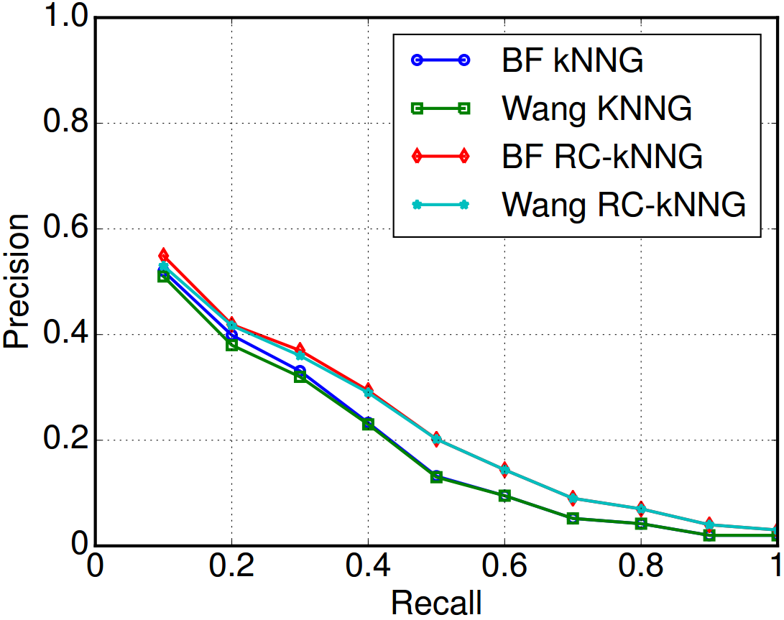
Evaluation: RC-kNNG retrieval performance
Our approach

